Slide 1
Digital Portfolio
STUDENT NAME: PAVUNKUMAR G
REGISTER NO AND NMID: astvu209209u09142
DEPARTMENT: BCA
COLLEGE: COLLEGE/ UNIVERSITY: SHANMUGA INDUSTRIES ARTS AND SCIENCE COLLEGE/THIRUVALLUR UNIVERSITY

Slide 2
PROJECT TITLE
Digital portfolio for web developer using html, css and javascript

Slide 3


AGENDA
Problem Statement
Project Overview
End Users
Tools and Technologies
Portfolio design and Layout
Features and Functionality
Results and Screenshots
Conclusion
Github Link
3/21/2024 Annual Review

Slide 4

PROBLEM STATEMENT
The absence of a personal portfolio makes it difficult for web developers to showcase their skills and projects.
This limits opportunities to connect with potential clients or employers.
A professional digital portfolio is needed to highlight expertise, projects, and contact details effectively.

Slide 5

PROJECT OVERVIEW
Develop a personal portfolio website using HTML, CSS, and JavaScript to showcase web development skills.
Include sections such as About Me, Projects, and Contact for clear presentation.
Design the portfolio to be responsive, user-friendly, and professional for career opportunities.

Slide 6

WHO ARE THE END USERS?
Potential Employers/Recruiters – to evaluate skills and hire for job opportunities.
Clients – to review past projects and decide on freelance or contract work.
Peers and Collaborators – to connect, network, and collaborate on web development projects.

Slide 7

TOOLS AND TECHNIQUES
Development Tools – HTML, CSS, JavaScript, and code editors like VS Code for building the website.
Design Techniques – Responsive design, CSS styling, and UI/UX principles for a modern layout.
Deployment Tools – GitHub Pages, Netlify, or Vercel for hosting and version control with Git.

Slide 8
POTFOLIO DESIGN AND LAYOUT
Homepage Layout – Includes a clean introduction with name, role, and a professional image on a black background.
Section Design – Separate sections for About Me, Projects, and Contact, arranged with clear navigation.
Responsive Design – Ensures the portfolio adapts to desktops, tablets, and mobile devices for better accessibility.
8

Slide 9
FEATURES AND FUNCTIONALITY
Project Showcase – Display completed projects with descriptions, images, and links to live demos or GitHub.
Interactive Contact Section – Provide contact details (email, WhatsApp, LinkedIn) with a simple form for inquiries.
Responsive Navigation – Easy-to-use menu and smooth scrolling for seamless user experience across all devices.

Slide 10
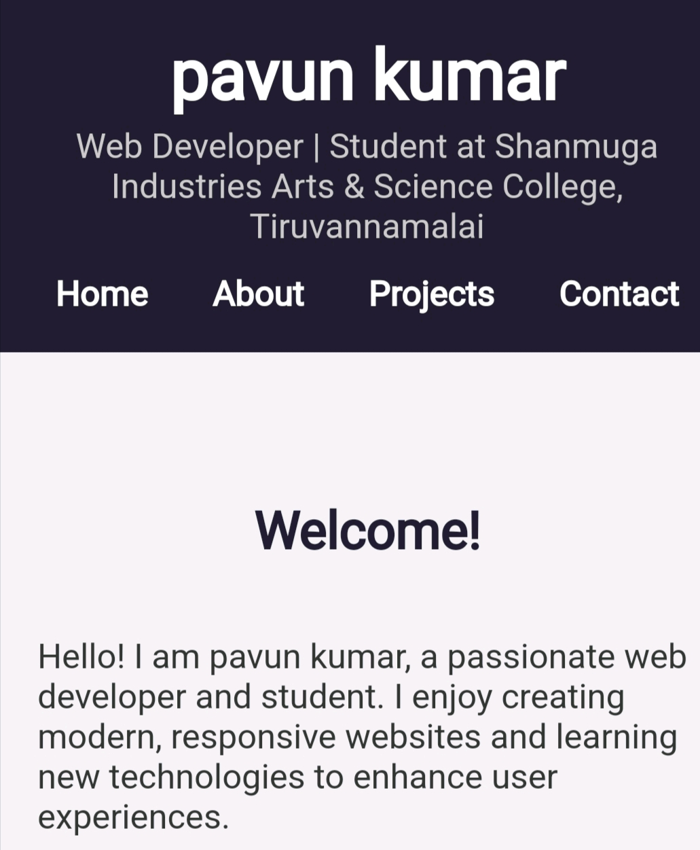

RESULTS AND SCREENSHOTS
Screenshots of each section
Before Vs after (HTML->With Css and JavaScript
3/21/2024 Annual Review
10

Slide 11
CONCLUSION
The Digital Portfolio Program helps users showcase their skills and projects easily.
It improves career opportunities by providing a professional digital profile
11

